Slide 1
Revision – Directed Numbers
Miss L
Year 8

Slide 2
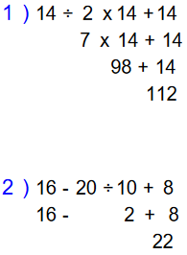
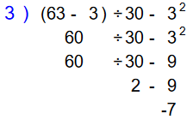
BIMDAS
Order of Operations / BIMDAS
1. Brackets First
2. Indices
3. Multiply and/or Divide
(from left to right)
4. Add or Subtract
(from left to right)

Slide 3


Slide 4

Little Birdy Method
4 + (-6)
1. This is the number that you start at on your number line
2. This symbol tells you which side of the number line to face
Positive – face right
Negative – face left
3. This tells you how much to walk forward or backwards
Positive – walk forward
Negative – walk backwards

Slide 5
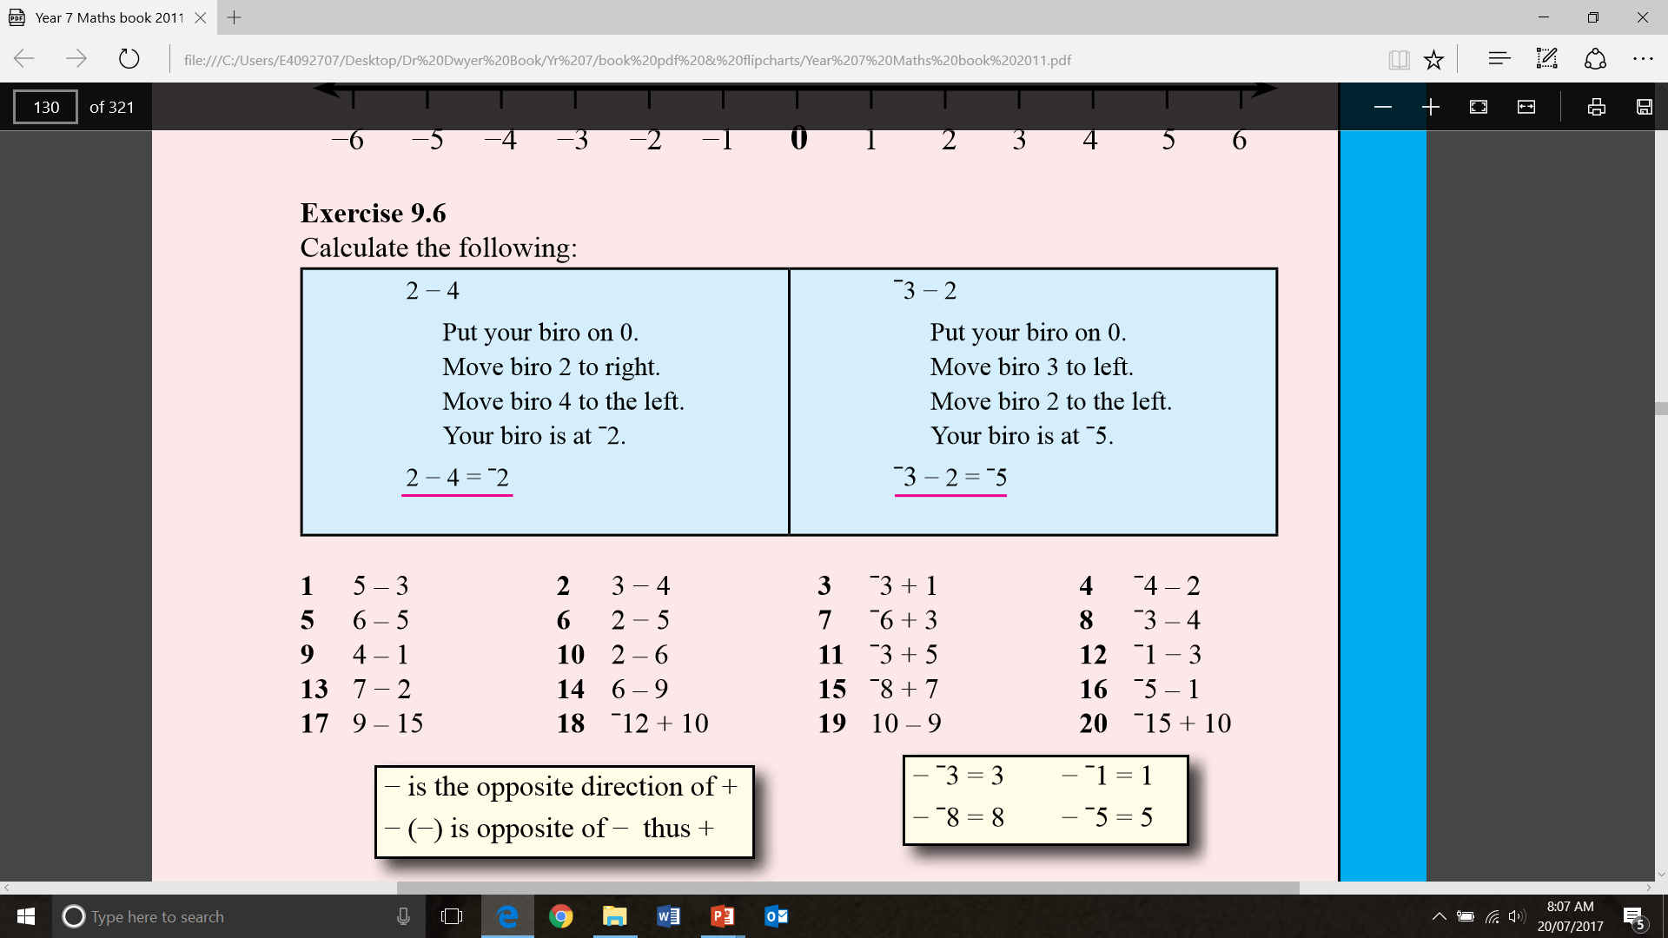

Slide 6
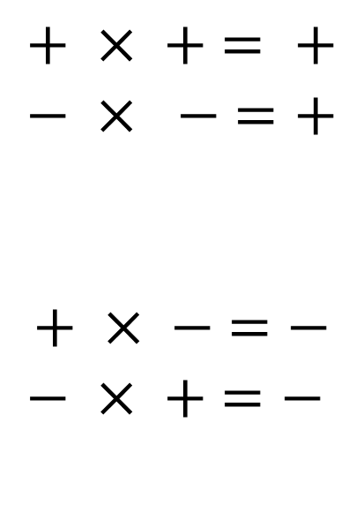
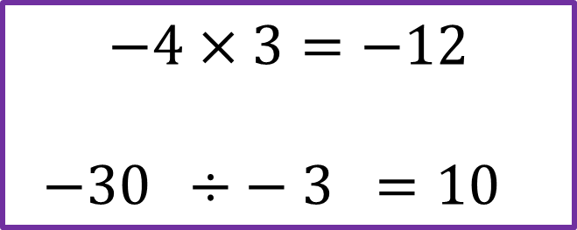
Multiply and Divide Integers
If both numbers are the same sign then the answer is positive
$$+ × + = +$$
$$− × − =+$$
$$+ × − =−$$
$$− × + =−$$
Same sign +
If both numbers are different signs then the answer is negative
Different signs –
$$−4×3=−12$$
$−30 ÷− 3 =10$

Slide 7
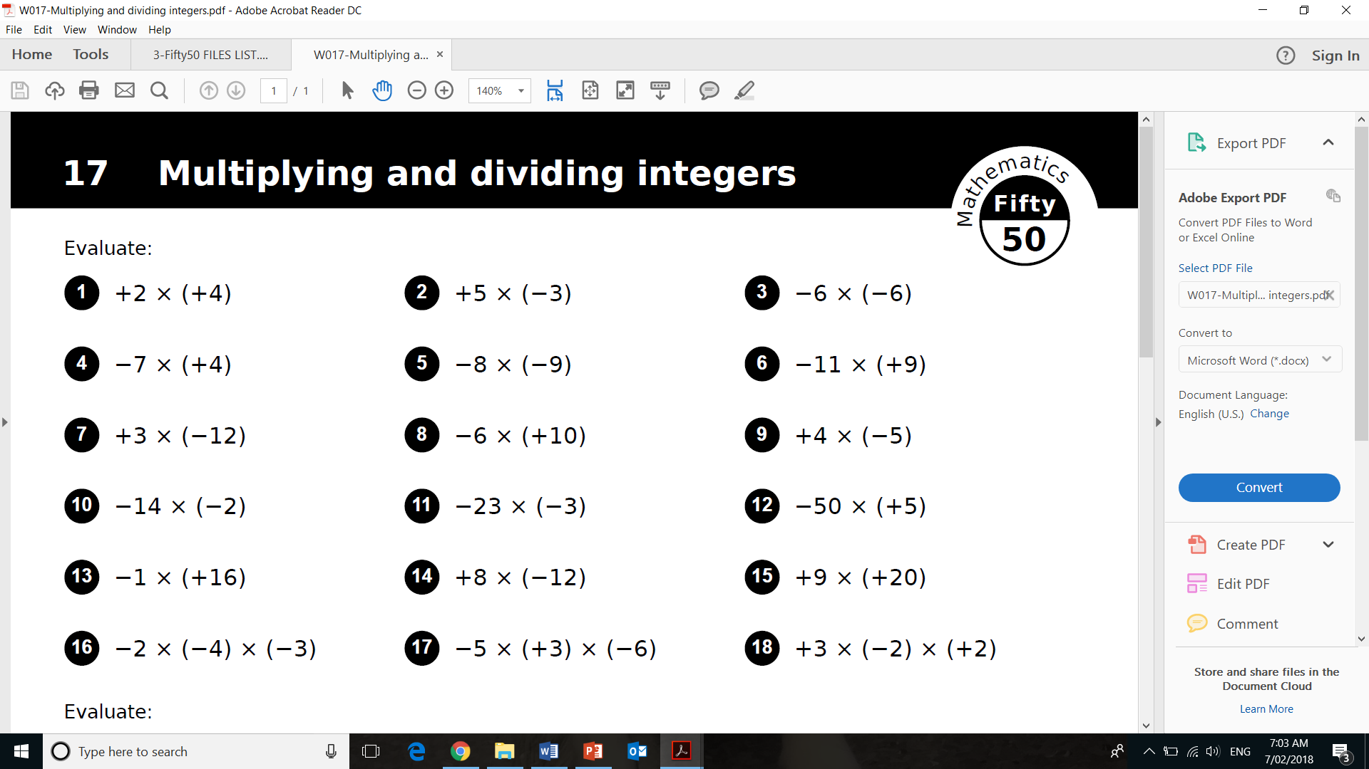
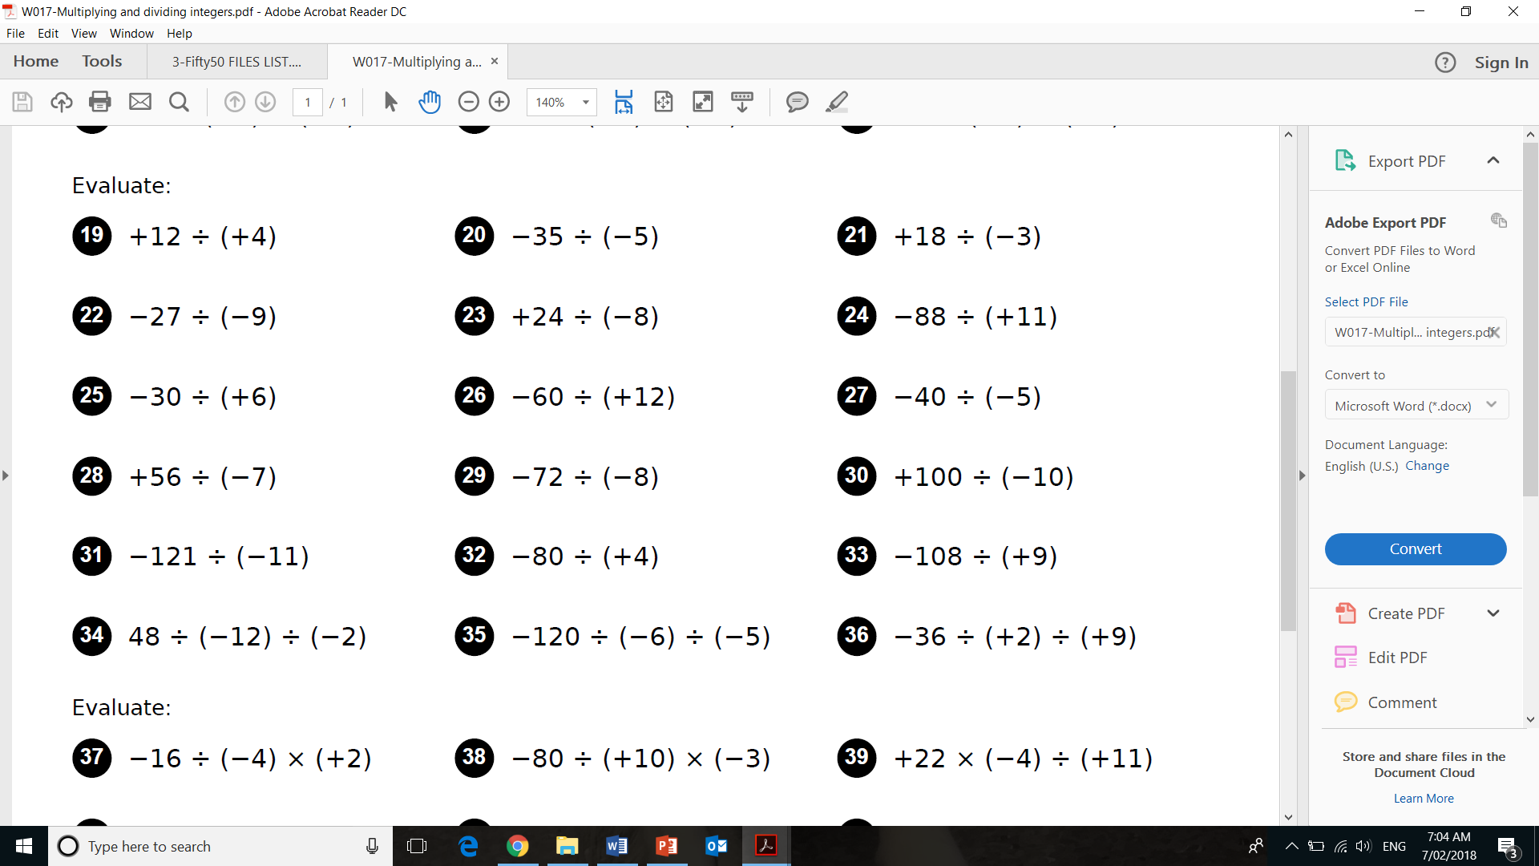

Slide 8
Special Numbers
A prime whole number has to be greater than 1 and only divisible by itself and 1; so it only has factors of 1 and itself.
A composite number is a whole number greater than 1 that is not a prime number. This means it has more factors than just itself and 1.

Slide 9
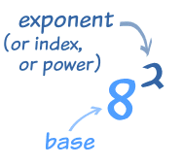


Index Notation
Examples of Factor Form
Examples of Index Form
4 x 4 x 4
$$4^{3}$$
$$6^{5}$$
6 x 6 x 6 x 6 x 6

Slide 10


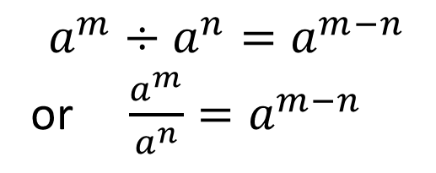

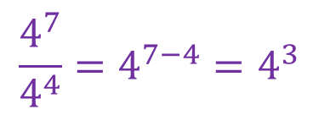
Index Laws
Index Law 1
Example
Example
Index Law 2

Slide 11
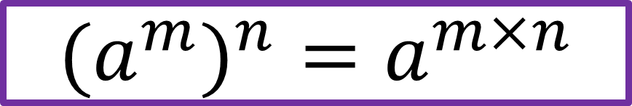

Index Laws
Index Law 3
$$(a^{m})^{n}=a^{m×n}$$
Index Law 4
$$a^{0}=1$$

Slide 12
